Slide 1

School of Computer Science and Engineering Department of Computer Science and Engineering
AI Powered Smart Library System-A semantic search and recommendation framework
Submitted by:
Anant Goel
Supervised By:
Mr. Bhawani Singh Rathore
2427030702

Slide 2
Outline
• Introduction
• Literature Review
• Problem Statement
• Objectives
• Proposed Methodology
• Results & Performance
Analysis
• Outcome & Contributions
• Future Work
• References

Slide 3
Introduction:
• Traditional library systems rely on exact keyword matching.
• Users must remember precise titles or author names.
• Systems fail to interpret natural or conversational queries.
• Limited discoverability leads to poor user experience.
• There is a growing need for semantic understanding in digital libraries.

Slide 4
Literature Review:
1. Keyword-Based OPAC Systems
• Relied on exact keyword matching.
• Required precise title or author input.
• No contextual understanding of queries.
2. TF-IDF and Vector Space Models
• Introduced weighted term relevance.
• Represented documents in vector space.
• Improved ranking but still keyword-dependent.
3. Word Embeddings
• Represented words as dense vectors.
• Captured semantic similarity between terms.
• Enabled meaning-based retrieval.
4. Transformer Models (BERT & LLMs)
• Use attention mechanisms for contextual understanding.
• Interpret complete sentence meaning.
• Represent the latest advancement in semantic search.

Slide 5
Recommendation & Advanced Semantic Techniques
1. Content-Based Filtering
• Uses item features such as descriptions and metadata.
• Suitable for libraries with limited user history.
• Forms the foundation of semantic recommendation systems.
2. Cosine Similarity
• Measures closeness between vector representations.
• Efficient and interpretable for ranking search results.
• Commonly used in information retrieval systems.
3. K-Nearest Neighbour (KNN)
• Identifies similar books based on vector proximity.
• Effective for structured and moderate-sized datasets.
• Simple yet reliable recommendation technique.
4. Large Language Models (LLMs)
• Built on transformer architecture for deep contextual understanding.
• Capable of interpreting complex and conversational queries.
• Enable intent extraction and semantic refinement before retrieval.
• Represent the next evolution of intelligent information systems.

Slide 6
Problem Statement Existing library systems rely heavily on exact keyword matching and fail to understand natural language queries. This often leads to irrelevant results and poor user experience. Therefore, there is a need for an AI-based system that enables semantic search and intelligent book recommendations.

Slide 7
Objectives • Interpret natural language queries using NLP techniques. • Implement semantic similarity using vector representations. • Rank search results using cosine similarity. • Provide intelligent recommendations using KNN. • Enable genre-based discovery. • Maintain modular and scalable architecture.

Slide 8
Proposed Methodology • User inputs natural language query. • Query undergoes NLP preprocessing (tokenization, stopword removal). • Text converted into vector embeddings. • Cosine similarity computed between query and book vectors. • Top-K relevant books retrieved. • KNN module generates similar book recommendations. • Results displayed with explanation panel.

Slide 9
System Overview • The system is divided into frontend and backend modules. • The frontend allows users to search using natural language. • The backend performs semantic processing and similarity matching. • Book descriptions are converted into vector form for comparison. • The modular design allows future AI integration.

Slide 10
Search & Recommendation Logic • User query undergoes basic NLP preprocessing. • The processed query is converted into a vector. • Cosine similarity is used to rank relevant books. • Top results are displayed based on semantic closeness. • KNN is used to recommend similar books.

Slide 11
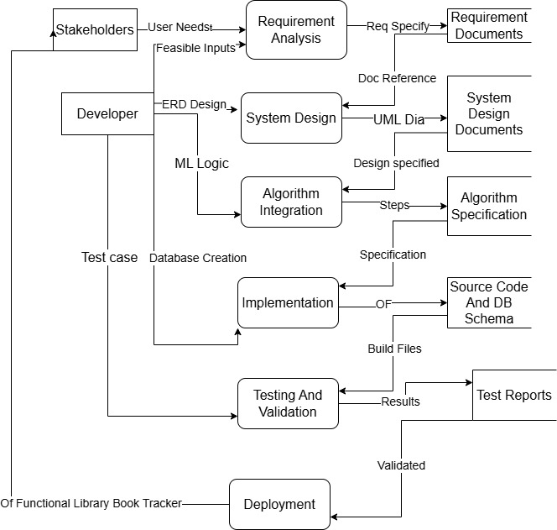
Data Flow Diagram Representing the Methodology Adopted for System

Slide 12
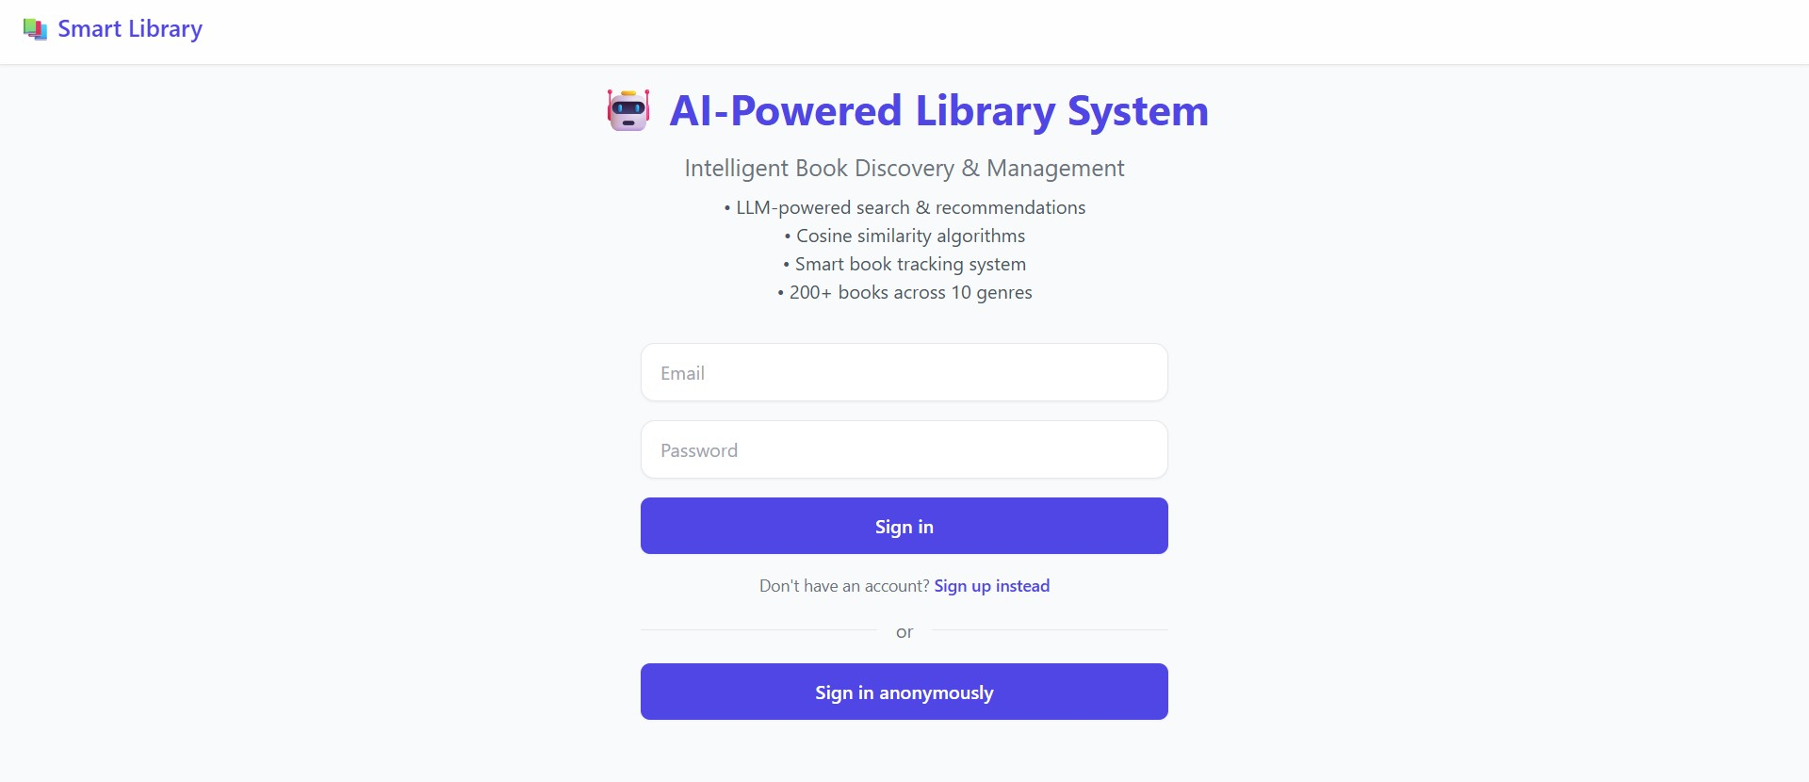
RESULTS

Slide 13
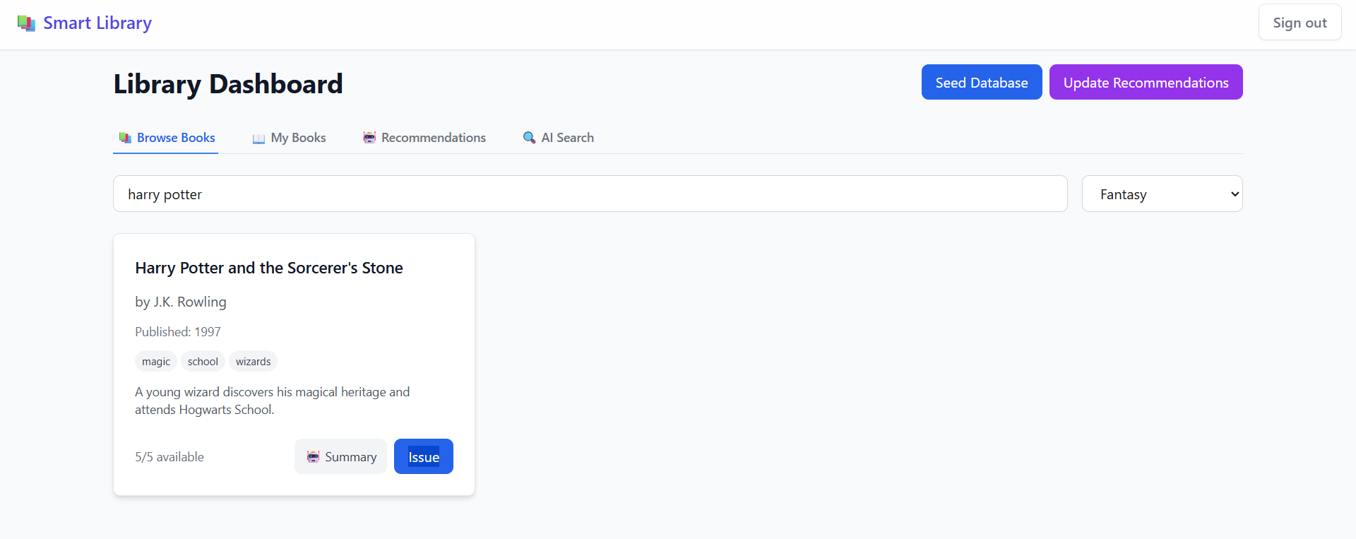

Slide 14
Outcomes • Functional AI-based semantic search engine developed. • Natural language query support implemented. • Content-based recommendation module integrated. • Explainable output system designed. • Tested on multi-genre dataset successfully.

Slide 15
Future Work • Integrate LLM-based query interpretation layer. • Enable conversational search interface. • Introduce voice-based search functionality. • Implement multi-turn context retention. • Explore domain-specific fine-tuning.

Slide 16
References:
References
• Manning & Schütze – Foundations of Statistical NLP, MIT Press.
• Mikolov et al. – Word2Vec, 2013.
• Devlin et al. – BERT Model, 2018.
• Ricci et al. – Recommender Systems Handbook.
• IEEE Xplore and ACM publications - On Semantic Search.

Slide 17
Thank You

